Slide 1


Terrain Recognition
upGrad
NAME :Kapil
REG NO :
SECTION :12013224
COURSE NAME : CSE 441 (INDUSTRY INTERNSHIP PROJECT)/ CSE 448 (INDUSTRY CO–OP PROJECT-II )
MENTOR NAME : Abhinaya

Slide 2
Introduction
upGrad
Terrain Recognition Using Deep Learning
Terrain recognition through deep learning has revolutionized our ability to interpret and understand diverse landscapes. Leveraging advanced neural networks, this cutting-edge technology enables automated identification and classification of terrains, ranging from rugged mountainous regions to expansive plains. By extracting intricate patterns and features from vast datasets, deep learning algorithms enhance our capacity to navigate, plan, and make informed decisions in a variety of applications, including autonomous vehicles, environmental monitoring, and disaster response.

Slide 3
About The Project
upGrad
Objective:
Terrain recognition using deep learning is to develop robust algorithms that can accurately identify and classify diverse landscapes, facilitating improved navigation and decision-making across various applications.Such as Google Earth and in space projects.
Dataset:
Dataset used here is collected from google earth by taking screenshots of different terrains of different arear and regions.

Slide 4
Data Preparation
upGrad
Data Collection and Data Perparation:
Data has been collected manually and has been stored under 3 major catagories ( train, step, validation). And each catagory contain 4 sub catagories (Grassy, Marshy, Rocky, Sandy).

Slide 5
Libraries Used
upGrad
Numpy
Pandas
Matplotlib
seaborn
Sklearn
Tensorflow + keras
opencv
imagebash

Slide 6
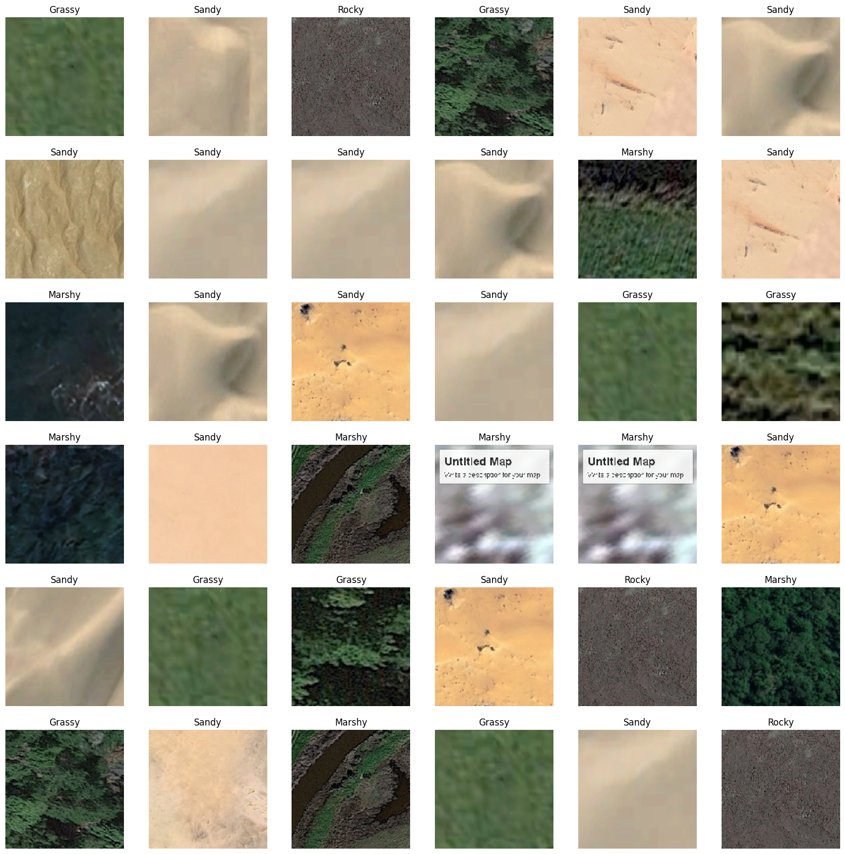
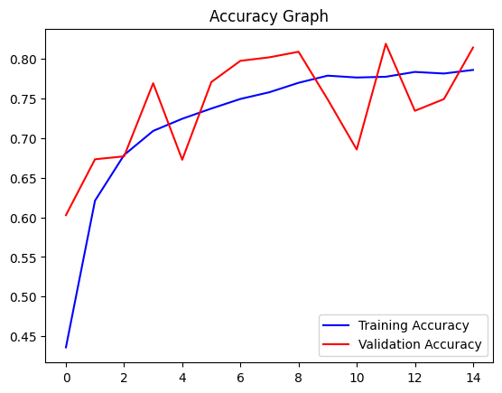
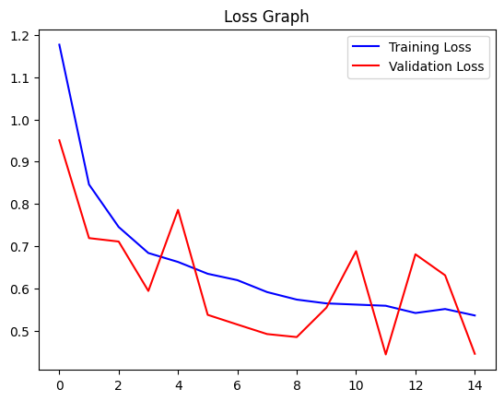
upGrad

Slide 7
Insights
upGrad
This technology enhances navigation precision, aids environmental monitoring, and supports disaster response. Its adaptive algorithms enable real-time terrain classification, allowing for informed decision-making and improved performance across diverse applications.

Slide 8
Conclusion
upGrad
In conclusion, Terrain Recognition powered by deep learning revolutionizes our understanding of landscapes. The adaptability of advanced algorithms enhances navigation, environmental monitoring, and disaster response. The ongoing advancements in this field promise a future where accurate terrain analysis plays a pivotal role in diverse applications, fostering efficiency and informed decision-making.

Slide 9
Thankyou
upGrad

